Slide 1



Mobile Disaster Management System
Comprehensive mobile app for disaster preparedness, response, and recovery.
by Group 20

Slide 2

Stakeholders
Authorities
Responders
Victims
Coordinate response efforts and manage resources.
Provide emergency services and on-ground assistance.
Receive alerts and request help during disasters.

Slide 3

System Goals
1
Improve Efficiency
Streamline disaster response processes.
2
Enhance Communication
Facilitate real-time information exchange.
3
Provide Situational Awareness
Offer up-to-date disaster information.
4
Enable Resource Management
Optimize allocation of emergency resources.

Slide 4

Current Problems
Manual Systems
Inefficient paper-based processes slow response times.
Lack of Real-Time Info
Delayed updates hinder effective decision-making.
Limited Accessibility
Information not readily available to all stakeholders.
Fragmented Communication
Uncoordinated channels lead to miscommunication.

Slide 5

New System Benefits
Real-Time Communication
1
Instant information exchange between all parties.
2
Enhanced Data Analysis
Advanced analytics for better decision-making.
Improved Accessibility
3
Information available anytime, anywhere via mobile app.
4
Streamlined Resource Management
Efficient allocation of emergency resources.

Slide 6

Functional Requirements
1
Incident Management
2
Resource Management
Log and track disaster incidents.
Allocate and monitor emergency resources.
3
Communication Tools
4
Situational Awareness
Facilitate messaging between stakeholders.
Provide real-time updates on disaster situations.

Slide 7

Non-Functional Requirements
Performance
Fast response times, even under heavy load.
Security
Robust data protection and user privacy.
Usability
Intuitive interface for all user types.
Interoperability
Seamless integration with existing systems.

Slide 8

User Roles
Role
Permissions
Admin
Full system access and management
Authority
Manage response efforts, issue alerts
Responder
Access incident data, update status
User
Receive alerts, report incidents

Slide 9

Data Requirements
1
Geospatial Data
Maps and location information for affected areas.
2
Meteorological Data
Weather patterns and forecasts for disaster prediction.
3
Historical Data
Past disaster information for trend analysis.
4
Infrastructure Data
Information on critical facilities and resources.

Slide 10
System Interfaces
User Interface
Admin Dashboard
API Integration
Intuitive mobile app for public users.
Comprehensive control panel for authorities.
Interfaces for external data sources.

Slide 11

Reporting and Analytics
1
Real-Time Reports
Up-to-date information on ongoing disasters.
2
Historical Analysis
Trends and patterns from past incidents.
3
Predictive Analytics
Forecast potential disasters based on data.
4
Performance Metrics
Measure response effectiveness and resource utilization.

Slide 12

Technical Constraints
Hardware Limitations
Ensure compatibility with various mobile devices.
Network Connectivity
Function in areas with limited internet access.
Data Storage
Secure and scalable storage solutions.
Battery Life
Optimize app for minimal power consumption.

Slide 13

Time Constraints
1
Requirements Gathering
Complete within first month.
2
Design Phase
Finalize in second month.
3
Development
Code and test over four months.
4
Deployment
Launch within six months of project start.

Slide 14

Budget Constraints
Development Costs
Allocate 50% of budget to coding.
Infrastructure
20% for servers and cloud services.
Testing
15% for quality assurance.
Marketing
15% for app promotion and user adoption.

Slide 15

Organizational Constraints
1
Regulatory Compliance
Adhere to government data protection laws.
2
Interagency Cooperation
Ensure seamless collaboration between different agencies.
3
Training Requirements
Develop comprehensive training programs for all users.
4
Change Management
Address resistance to new technology adoption.

Slide 16




Dependencies
Third-Party APIs
Government Databases
Telecom Infrastructure
Integration with weather and mapping services.
Access to official disaster-related information.
Reliable communication networks for app functionality.

Slide 17

Acceptance Criteria
1
Functionality
All features work as specified.
2
Performance
App responds within 2 seconds.
3
Usability
90% user satisfaction in testing.
4
Security
Pass all vulnerability assessments.

Slide 18
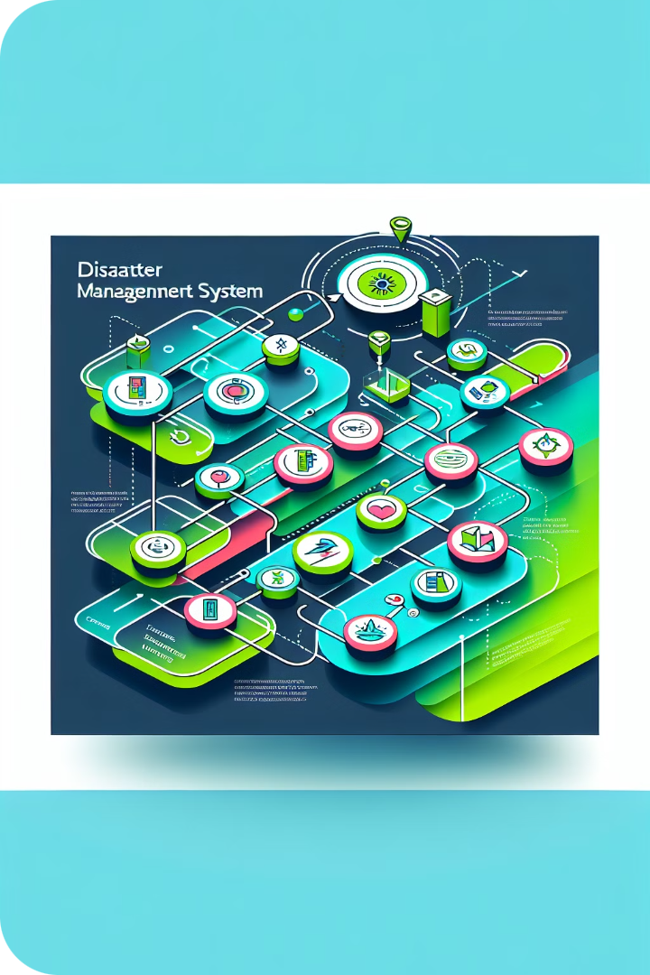
Context Diagram 1/2
Central System
Core disaster management application.
External Entities
Users, authorities, and data providers.
Data Flows
Information exchange between system and entities.

Slide 19
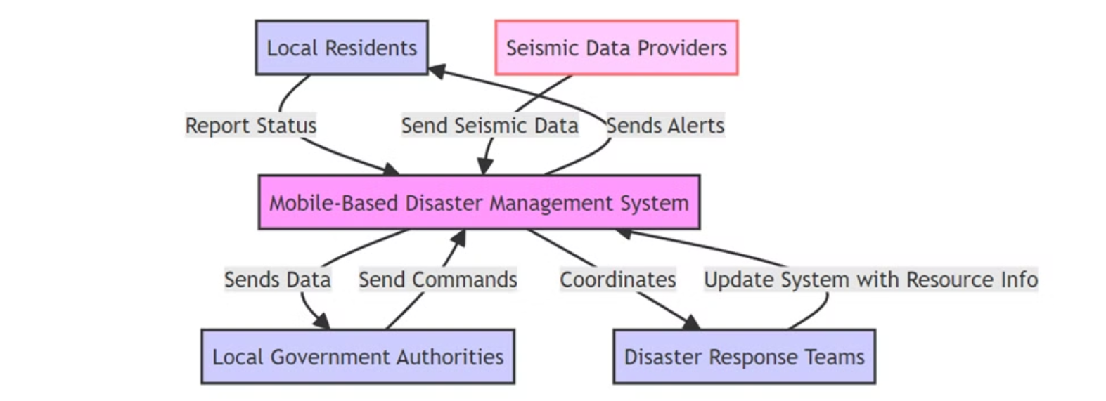
Context Diagram 2/2

Slide 20

Use Case Diagram 1/2
1
User Actions
Receive alerts, report incidents, request help.
2
Authority Actions
Manage resources, issue alerts, coordinate response.
3
System Functions
Process data, generate reports, send notifications.

Slide 21
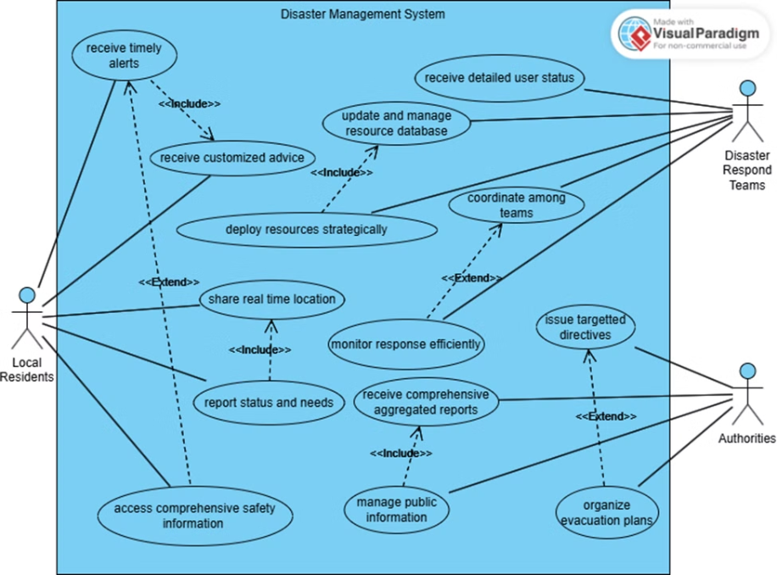
Use Case Diagram 2/2

Slide 22
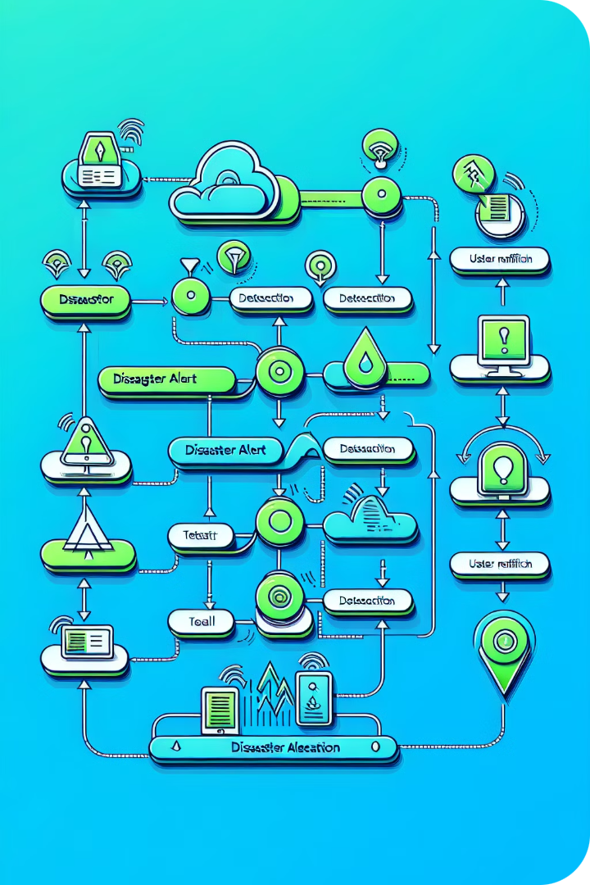
Sequence Diagram 1/2
1
Disaster Detection
System receives data from sensors.
2
Alert Generation
System creates and validates alert.
3
Authority Approval
Officials review and approve alert.
4
User Notification
Alert sent to user devices.

Slide 23
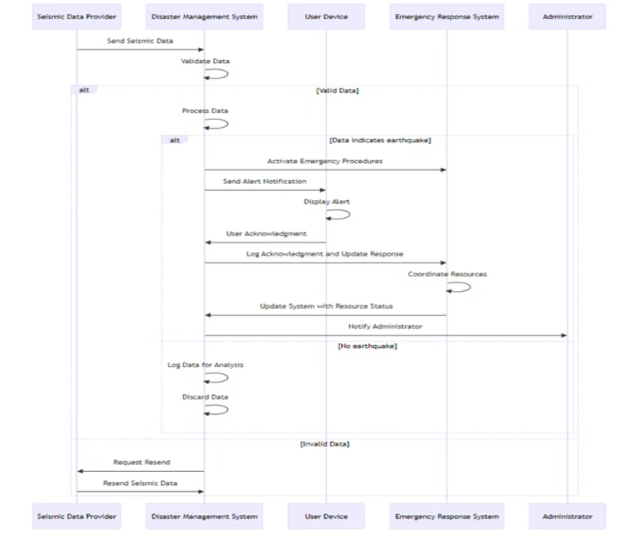
Sequence Diagram 2/2

Slide 24
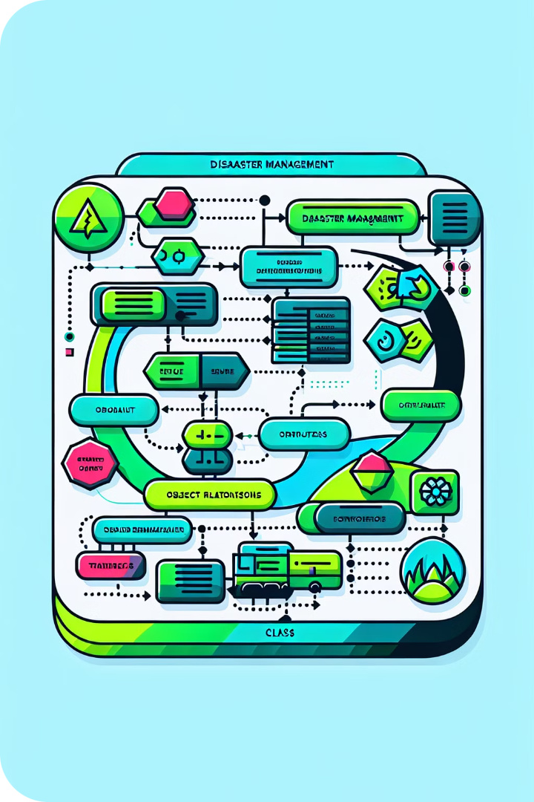
Class Diagram 1/2
User Class
Attributes: ID, name, location. Methods: reportIncident().
Alert Class
Attributes: type, severity. Methods: sendAlert().
Resource Class
Attributes: type, quantity. Methods: allocateResource().

Slide 25
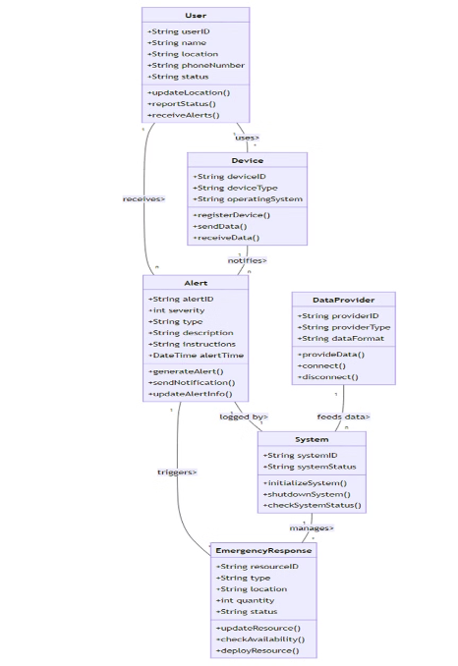
Class Diagram 2/2

Slide 26
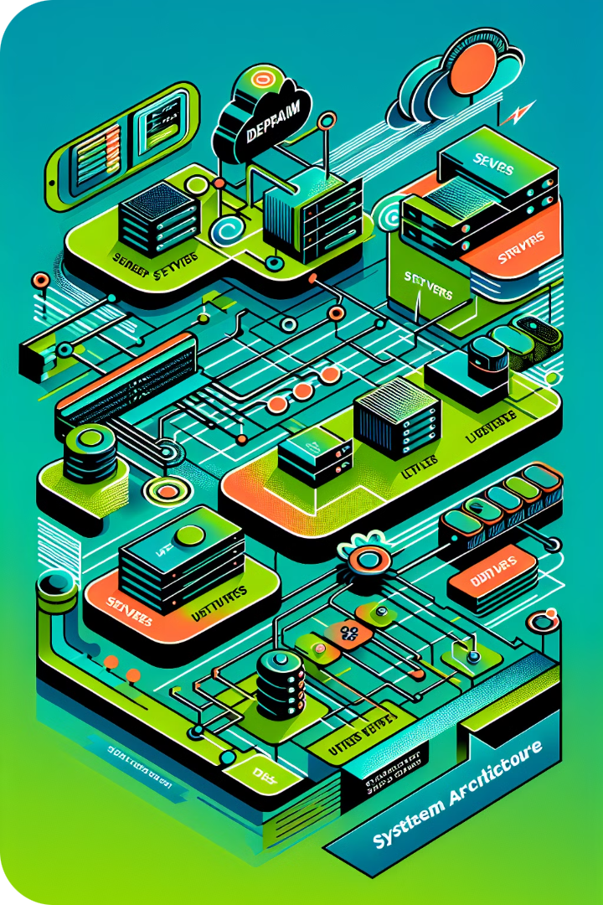



Deployment Diagram 1/2
User Devices
Smartphones and tablets running the app.
Application Servers
Process requests and manage data.
Database Servers
Store and retrieve system data.

Slide 27
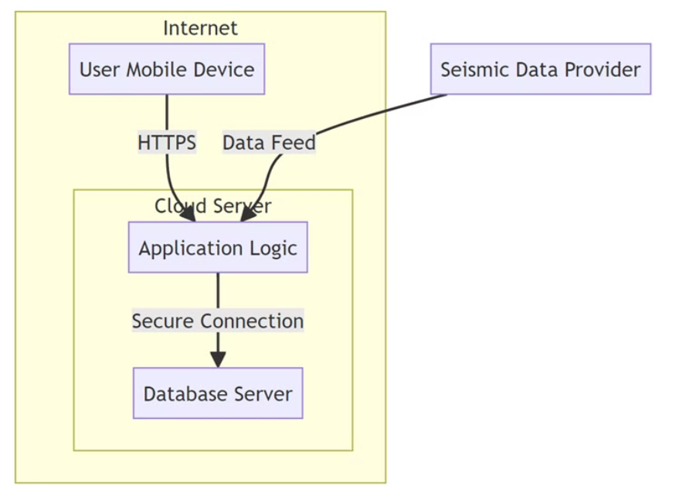
Deployment Diagram 2/2

Slide 28

UI Design Process
Requirement Gathering
1
Engage with potential users to understand needs and preferences.
2
Wireframing
Develop basic layouts focusing on functionality and user flow.
Prototyping
3
Create interactive prototypes using Figma to visualize user experience.

Slide 29
UI Design Process (Continued)
User Testing
1
Conduct usability testing with diverse users to identify issues.
2
Iteration
Refine designs based on feedback and testing results.
Final Design
3
Ensure the final product meets user expectations.

Slide 30



Figma as a Design Tool
Real-Time Collaboration
Prototyping Capabilities
Accessibility
Multiple designers can work on the same project simultaneously.
Allows creation of interactive prototypes to visualize user flows.
Cloud-based tool ensures design files are easily accessible from anywhere.

Slide 31


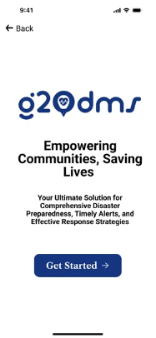
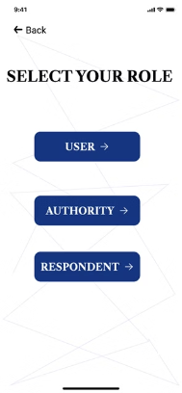
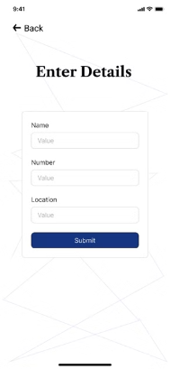
UI Screens: Splash Welcome and on-boarding

Slide 32
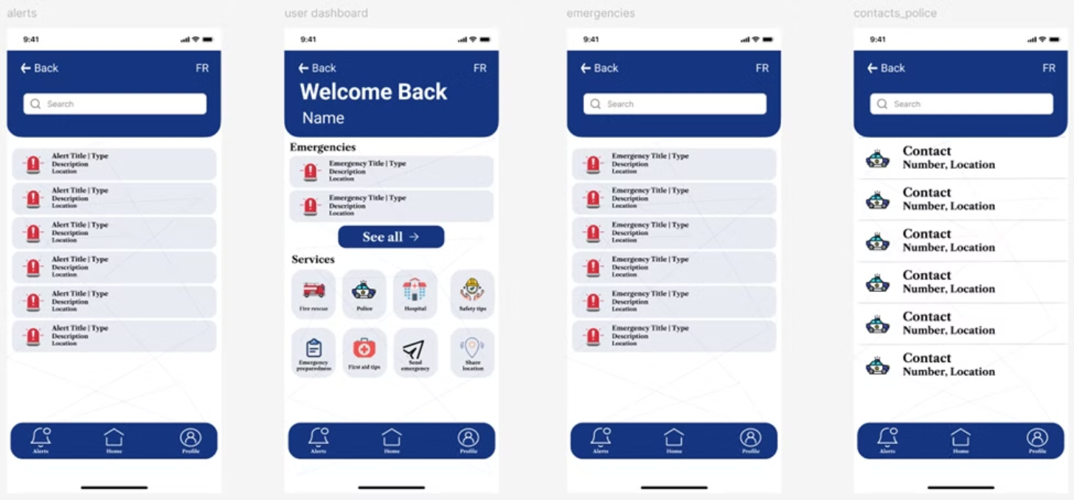
UI Screens: User 1/3

Slide 33
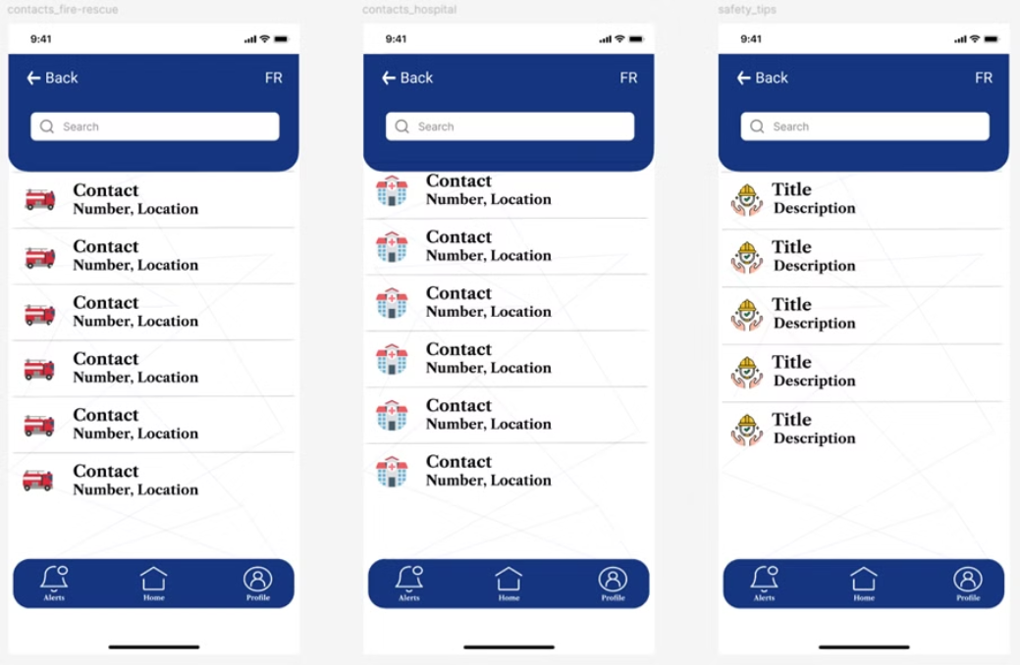
UI Screens: User 2/3

Slide 34
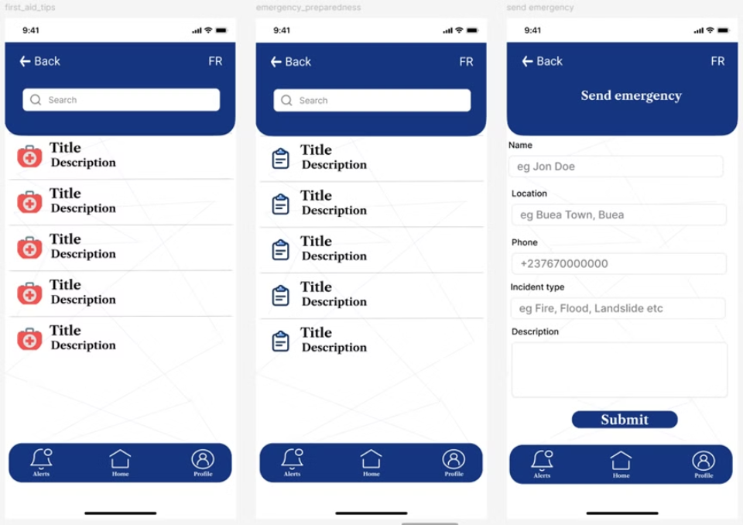
UI Screens: User 3/3

Slide 35
UI Screens: Respondents 1/2

Slide 36
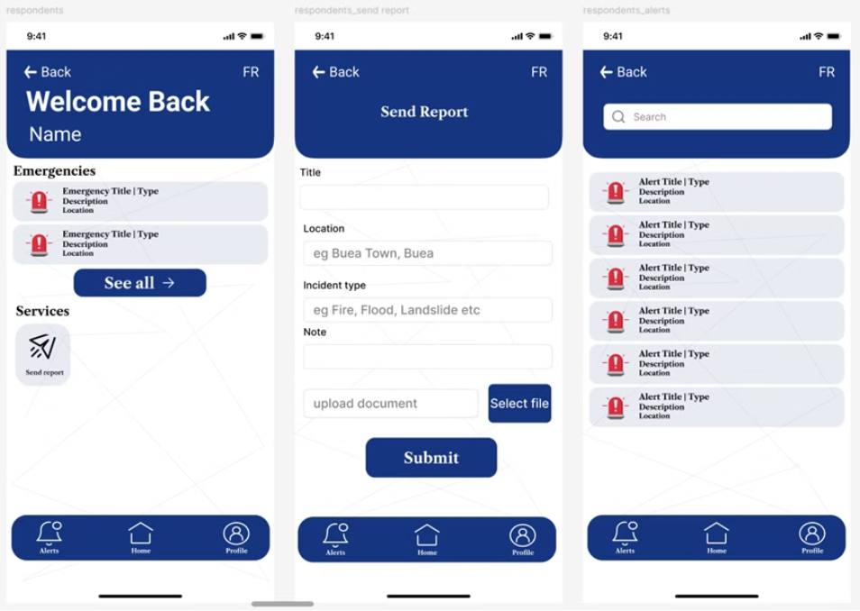
UI Screens: Respondents 2/2

Slide 37
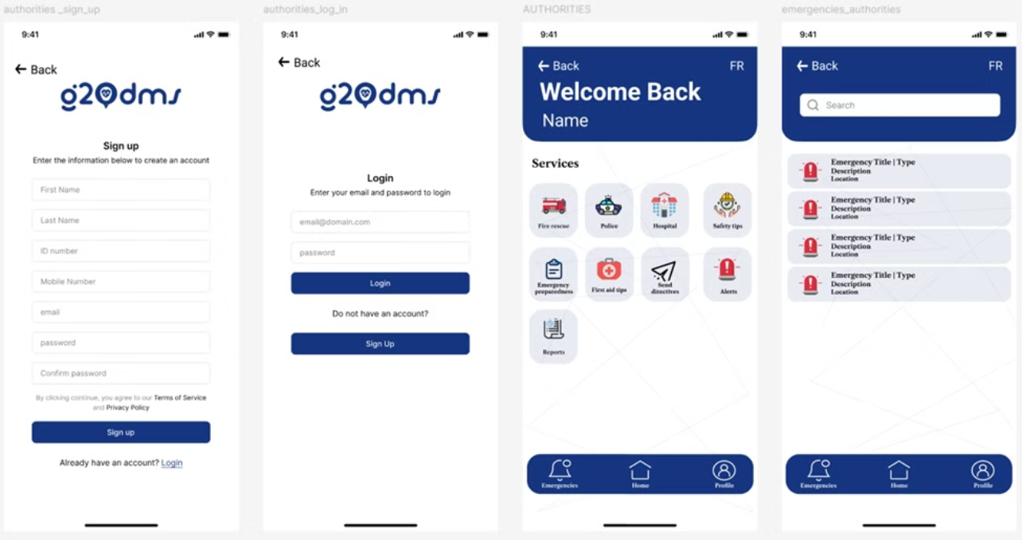
UI Screens: Authorities 1/4

Slide 38
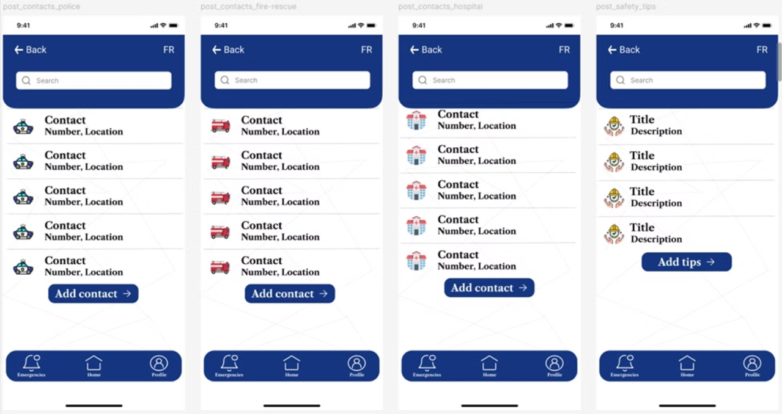
UI Screens: Authorities 2/4

Slide 39
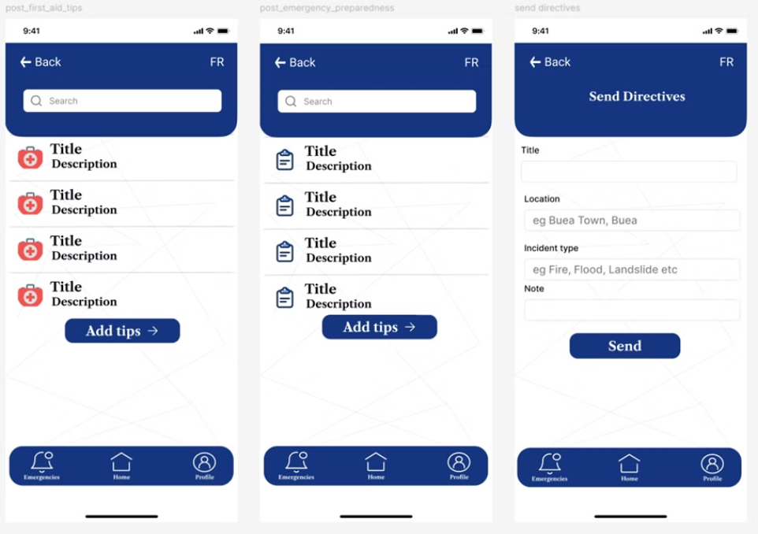
UI Screens: Authorities 3/4

Slide 40
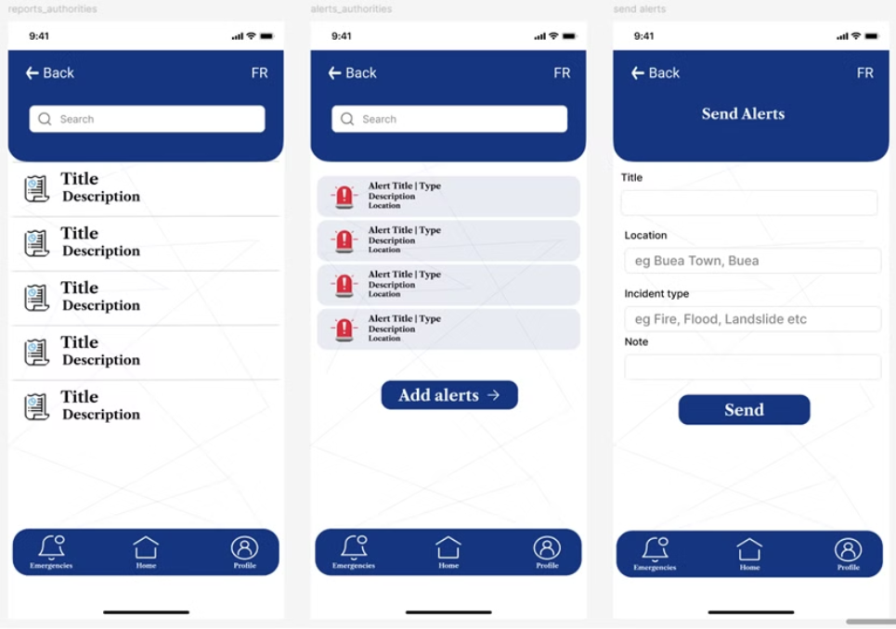
UI Screens: Authorities 4/4

Slide 41
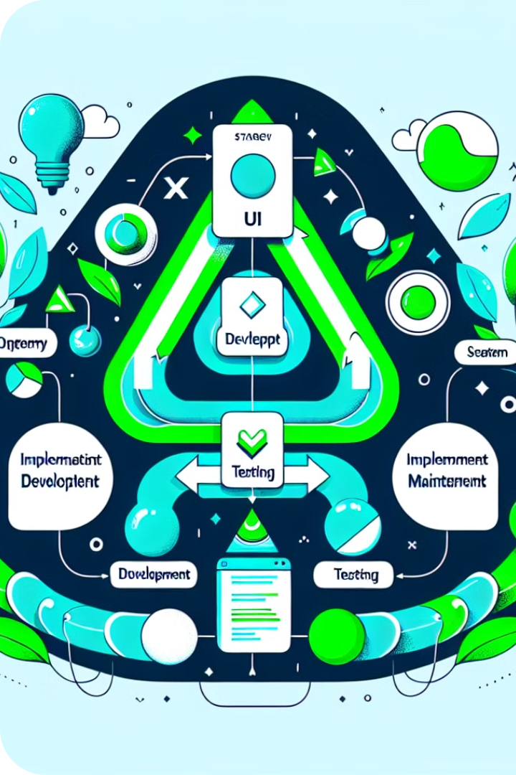
UI Implementation Strategy
Development
Using Flutter for cross-platform consistency.
Testing
Conducting thorough usability and functional testing.
Maintenance
Regularly updating the app based on feedback and advancements.

Slide 42
Coding and Version Control
GitHub Repository
Continuous Integration
Code uploaded to GitHub for version control and collaboration.
Ensures code quality and facilitates frequent updates.
1
2
3
Open Source
Promotes transparency and community contributions.

Slide 43
Database Design: Conceptual phase 1/2
Users
Authority
Individuals using the system, including the general public and disaster victims.
Government and agency officials responsible for disaster response.
Respondents
Emergency
First responders and emergency services.
Types and details of emergencies.

Slide 44
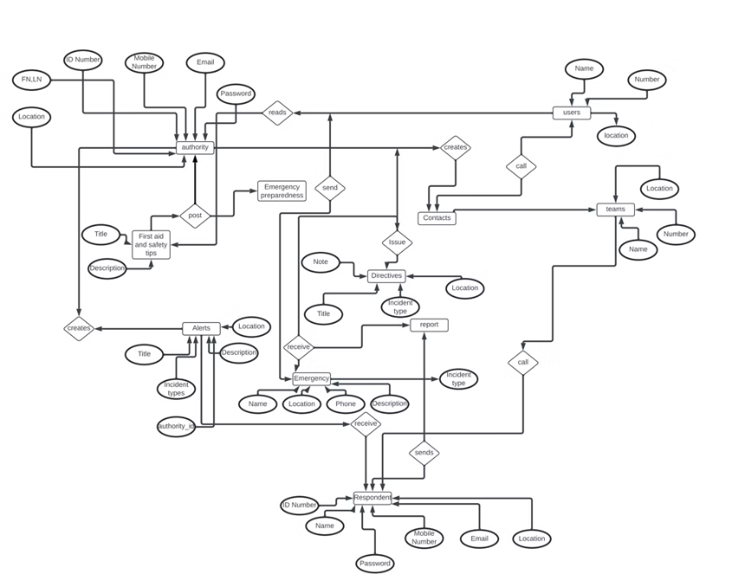
Database Design: Conceptual phase 2/2

Slide 45
Database Design: Logical Phase 1/2
Schema Definition
Attribute Definition
Key Establishment
Created tables reflecting system entities like Users, Authorities, and Emergencies.
Defined attributes such as ID Number, Name, and Location.
Established Primary and Foreign Keys for referential integrity.

Slide 46
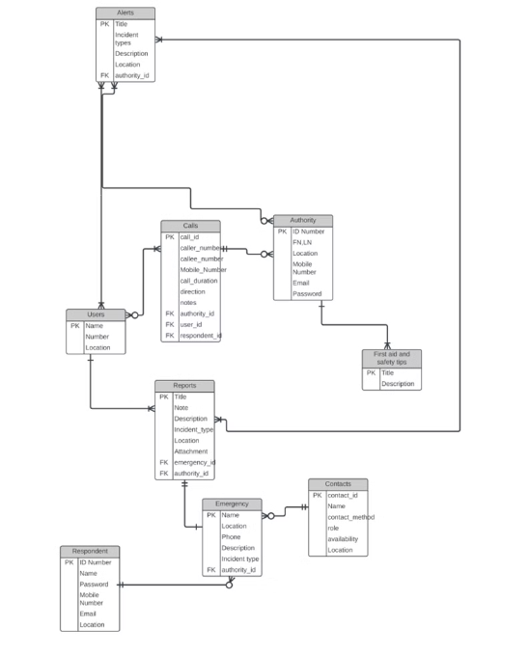
Database Design: Logical Phase 2/2

Slide 47
Database Design: Physical Phase
DBMS Selection
Indexing
Partitioning
Chose MySQL Workbench for robustness and scalability.
Implemented on frequently accessed fields to speed up queries.
Employed on historical data to improve performance and manageability.

Slide 48
Database Design: SQL Database Implementation
SQL Scripts Creation
1
Wrote scripts to create tables and define relationships.
2
Execution
Ran scripts to set up the database structure.
Verification
3
Checked database integrity and relationships.

Slide 49
Database Design: Technologies used
Lucid chart
draw.io
Mysql workbench
SQL editor
VScode

Slide 50
Conclusion
The DMS aspires to set a new standard in disaster management, embodying a proactive and coordinated approach to addressing the challenges posed by natural disasters.

Slide 51
THANK YOU

